Slide 1

Design pattern
Lecture 6

Slide 2
builder

Slide 3
Introduction
The car is a more complex object. Its composition includes Chassis, Frame, Wheels, Engine, Gas Tank, Accelerator, Brake, Steering wheel. ,Battery, Audio, Sunroof, Cruise Control, GPS, etc.
In order to decouple the process of building a complex object from its components, the software design uses a class to separately encapsulate the process of constructing a class. This class is called the Director class. Designing another class is responsible for producing different part class objects that meet certain conditions. This class is called the CarBuilder class; in addition, it needs a class package product called Car.
The Builder pattern is to create a complex object step by step, which allows the user to construct them only by specifying the type and content of the complex object. The user does not know the internal concrete construction details. The concrete interaction for constructing a Car object can be represented by a sequence diagram, as shown in Figure 1.

Slide 4
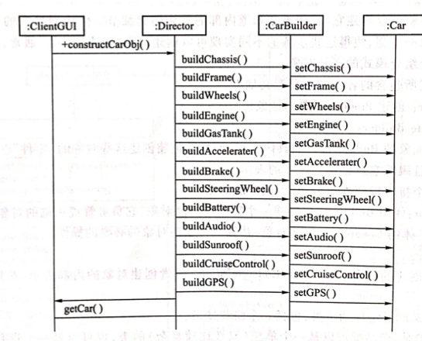
Introduction
Figure 1 Car assembly system sequence diagram

Slide 5
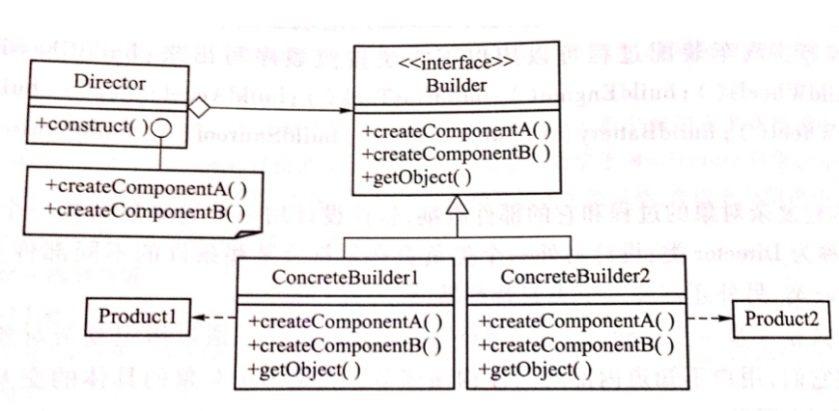
Builder—Concepts and Mechanisms
Builder pattern separates the construction of a complex object from its representation so that the same construction process can create different representation. The class diagram design for the Builder pattern is shown in Figure 2.
Figure 2 Class diagram of Builder pattern

Slide 6
Builder—Concepts and Mechanisms
Figure 2 Class diagram of Builder pattern
Director director = new Director();
director.setBuilder(cb);
director.construct();
if ( cb == 1 ) Product1 = director.getObject();
else Product 2 = director.getObject();

Slide 7
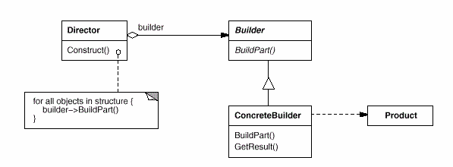
Builder
Applicability
Use the Builder pattern when
The algorithm for creating a complex object should be independent of the parts that make up the object and how they are assembled.
The construction process must allow different representations for the object that is constructed
Structure
Figure 3 Builder pattern structure

Slide 8
Builder—Examples
A company needs to design a home purchase system. The houses in the system are divided into two types: Normal House and Luxury House. The difference between different types of housing is reflected in the size of the Area and the number of Bedrooms, Bathrooms, Garages, Gardens, and Swimming pools. According to the user‘s choice, the software uses three graphical interfaces for the user to select various indicators of the house. This program uses Builder pattern.

Slide 9
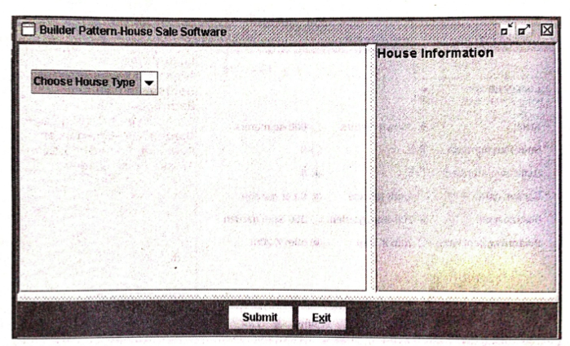
Builder—Examples
The main interface of the program is shown in Figure 4. At the top left of the graphical interface, there is a “Choose House Type” pick list with Normal House and Luxury House options.
Figure 4 House purchase system main graphical interface

Slide 10
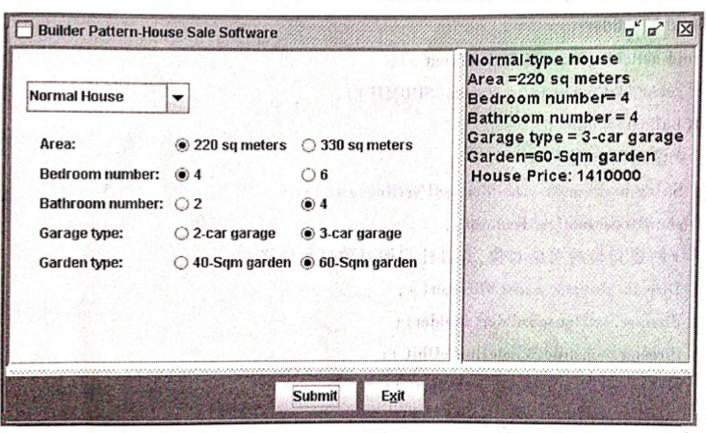
Builder—Examples
New sections in the Normal House interface include Area, Bedroom number, Garage type, and Garden type. Each selection contains two options.
Figure 5 House Purchase System Normal House Graphical Interface

Slide 11
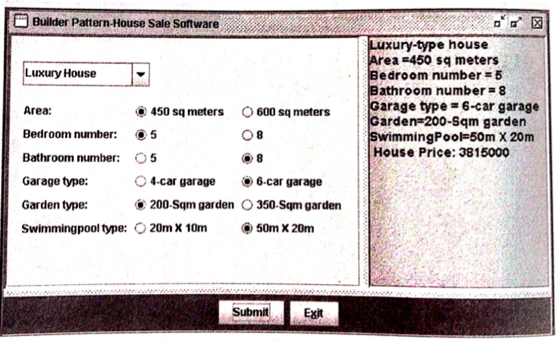
Builder—Examples
The house properties section of the Luxury House interface contains Area, Bedroom number, Garage type, Garden type, and Swimming pool type. Each selection contains two options.
Figure 6 House Purchase System Luxury House Graphical Interface

Slide 12
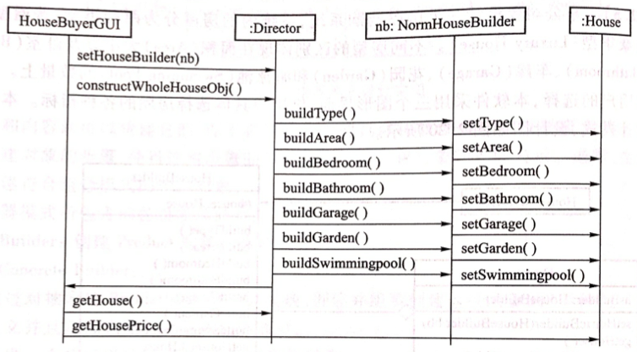
Builder—Examples
The house purchase system includes a main user graphical interface. When the program is running, according to the user‘s selected input: Normal House or Luxury House, the two user graphical interfaces will be embedded in the main user graphical interface for the user to select the houses Item indicators. Finally, the user’s selection information will be displayed synchronously in the text box of the main graphical interface. The sequence diagram of the house purchase system is shown in Figure 7
Figure 7 The sequence diagram of the House Purchase System

Slide 13
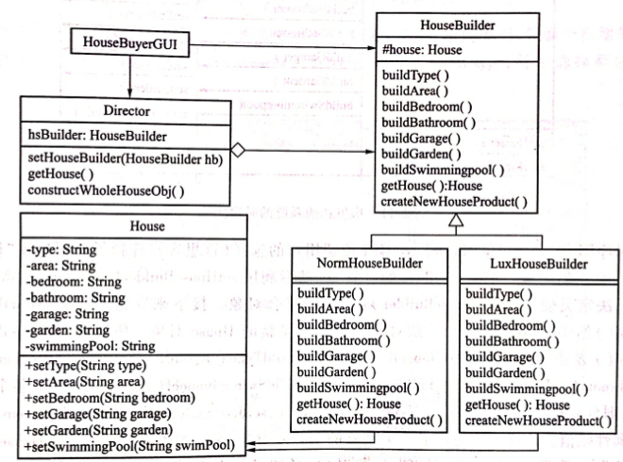
Builder—Examples
This program adopts Builder Pattern. The design diagram is shown in Figure 8.
Figure 8 House Purchase System Designed Using Builder pattern

Slide 14
Builder—Examples
Figure 8 House Purchase System Designed Using Builder pattern
Director director = new Director();
director.setHouseBuilder( hb );
director.constructWholeHouseObj();
House hsObj = director.getHouse();

Slide 15
Singleton

Slide 16
Singleton
Intent
Ensure a class only has one instance, and provide a global point of access to it.
Motivation
It is important for some classes to have exactly one instance. Although there can be many printers in a system, there should be only one printer spooler. There should be only one file system and one window manager.
Solution
Make the class itself responsible for keeping track of its sole instance. The class can ensure that no other instance can be created (by intercepting requests to create new objects), and it can provide a way to access the instance.

Slide 17
Singleton
The basic idea
Declare a constructor as a private type, and other types cannot use this constructor to create an object.
Provide a getInstance method that can get an instance. This method is a static method that ensures that the client gets the same object at all times.
Public class Singleton {
private static Singleton instance;
private String name;
private Singleton (String name) {
this.name = name;
}
public static Singleton getInstance (String name) {
if (instance == null && ! name.equals(null))
instance = new Singleton (name);
return instance;
}
}

Slide 18
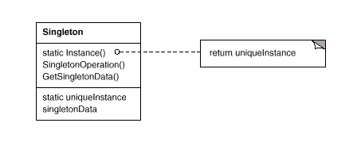
Singleton
Figure 9 Singleton pattern structure
Instance is a static variable, of type Singleton, used to store instances that have already been created. GetInstanceData() creates a method for the instance. It creates the instance in a very special way. If an instance was previously created (and therefore stored in the variable instance), the method returns an instance; if the previous Singleton instance was not created, then The method newly creates and returns an instance of the Singleton class, thus ensuring the uniqueness of the instance

Slide 19
Singleton
Applicability
Use the Singleton pattern when
There must be exactly one instance of a class, and it must be accessilbe to clients from a well-known access point.
When the sole instance should be extensible by subclassing, and clients should be able to use an extended instance without modifying their code.

Slide 20
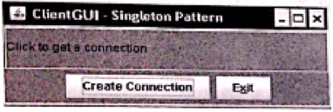
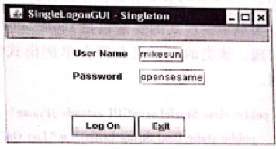
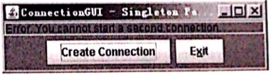
Singleton—Examples
Consider a company's internet connection. The company's external Internet uses a unified IP address, and all internal users use a unified internal server. When a user wants to connect to the Internet, the user should first connect to the internal server. Obviously, if a user has already started a connection, the user can no longer have a second connection.
Figure 10 ClientGUI generated user interface
Figure 11 The graphical interface generated by the SingleLogonGUI class
Figure 12 ClientGUI interface – the situation when the user clicks the "Create Connection" button again

Slide 21
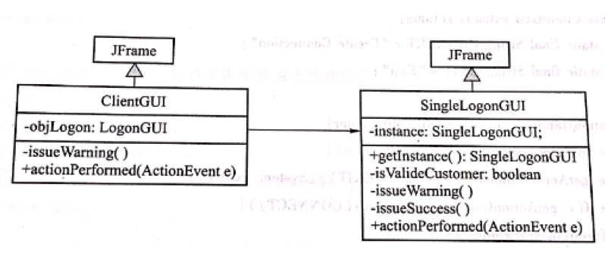
Singleton—Emamples
Figure 13 Internet connection system class diagram designed using singleton pattern

Slide 22
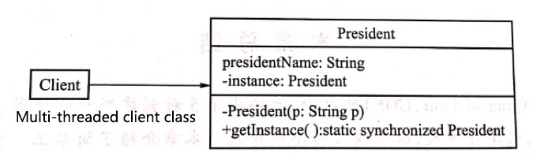
Singleton—Examples
Singleton Pattern must be used carefully in multithreaded applications. If two threads simultaneously call the create method when the only instance has not yet been created, it will cause each of the two threads to create an instance of the same, thereby violating the original intention of the uniqueness of the singleton pattern. In order to improve the above design, the getInstance() method in the design can be declared as synchronized.
Figure 14 The president class diagram designed using the linear security singleton pattern
President ins = President.getInstance();

Slide 23
Singleton—Examples
Solution 1—Use the synchronized keyword
public static Singleton getInstance() {
if (singleton == null) {
synchronized (Singleton.class) {
if (singleton == null) {
singleton = new Singleton();
}
}
}
return singleton;
}
Solution 2 — Obtained by an internal static class
public class Singleton {
private static Singleton singleton;
public static Singleton getInstance() {
return SingletonHolder.mSingleton;
}
private static class SingletonHolder {
private static final Singleton mSingleton = new Singleton();
}
}

